Slide 1

IMD 311 INTRODUCTION TO WEB CONTENT MANAGEMENT OF DESIGN
CASE STUDY
(KAKI JERSI)
NUR AFIQAH BT ABDUL MALIC @ ABDUL MALIK (2017368607)
NUR AMIRAH BT ZAMRIN (2017333471)
SITI NAJIHA BT NAZARI (2017333913)
SITI HAISYA AMIRAH BT AMIR (2017378419)

Slide 2
1. BACKGROUND OF THE WEBSITE

Slide 3
WHO
WHAT
WHEN
Sports equipment shop business.
Sells sports good to a company.
They deliver the freshest kit designs, the most versatile cherry fabrics, custom design and a complete line of equipment for your own club.
Kaki Jersi also in apparel and fashion industries category.
Created in 2017.

Slide 4
WHY
WHERE
HOW
To inform Kaki Jersi's new and existing customers of all the information they needed.
To advertise the goods and products of Kaki Jersi.
It can be found with any device that has internet connection in any Internet search engine.
In addition to displaying its products and services, Kaki Jersi informs its customers about its company and its mission.
You can find all the great content you create in your business in order to inform and involve your target audience on your website.

Slide 5
2. NATURE BUSINESS OF THE WEBSITE

Slide 6
WHO
WHY
WHAT
The premier destination online to buy custom, sublimated soccer jerseys, shorts and gear.
Provided a high quality of product with the affordable prices.
Kaki Jersi manufactures their own items.
The believe that can find an opportunity in making their own local brand jersey and sportswear.
A manufacturing business which is a business that uses components, parts or raw materials to make a finished good.
It can be sold directly to consumers or to other manufacturing businesses.
Comprised of machines, robots, computers and humans that all work in a specific manner to create a product.

Slide 7
WHEN
WHERE
HOW
Kaki jersi started their business in 2015
After high demand, they started receiving online orders and created a website in 2017.
They moved into a new factory in Batu Caves in 2016.
It is located at NO. 7, Jalan Sri Batu Caves 9, Taman Sri Batu Caves, 68100 Batu Caves, Selangor.
Having a good strategy by sponsors an event which could promote the brand more.

Slide 8
3. UX/UI OR THE WEBSITE

Slide 9
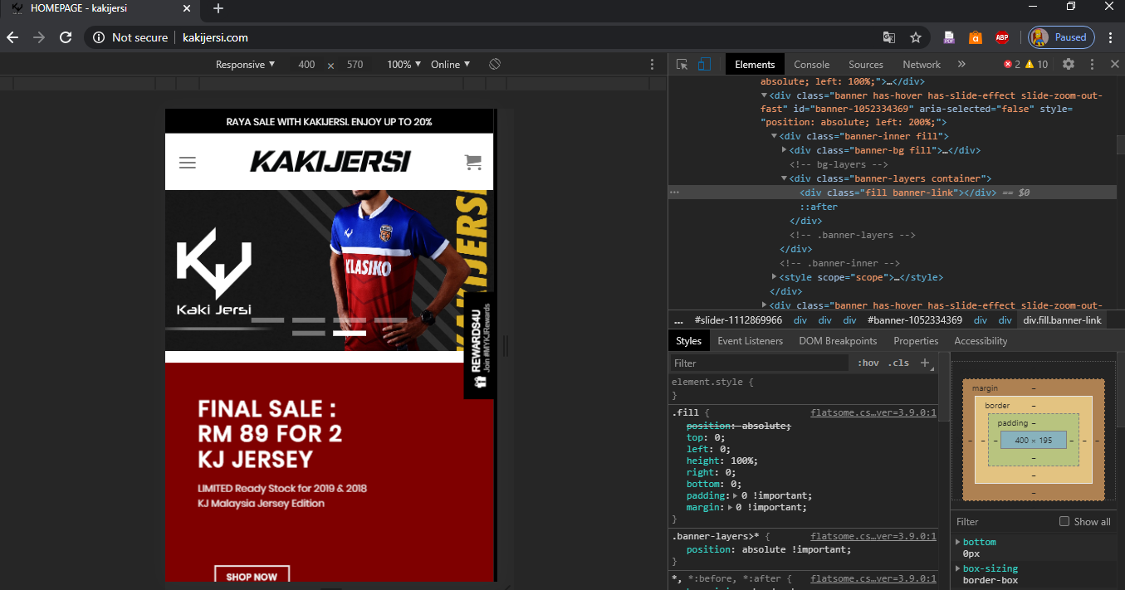

Slide 10
WHO
WHY
WHAT
Website developer are remained anonymous but there are a dedicated page on ‘About Us’
Provide a dedicated email which are kakijersidotcom@gmail.com for their clients on behalf of asking any business related questions
Use WordPress for designing their websites, keeping data of their user’s accounts, and updating any new items.
It shows a very simplistic use of fonts with an organize overall interface starting from the navigation section until footers.
Use a general and basic style of user interface
The website developer created an organize product by their columns and rows.
User also does not have any difficulty in finding their items.

Slide 11
WHEN
WHERE
HOW
Deliver all the information their customer needs to take which include customer care, info and follow us
All of the information that given are in fact accurate and same goes with all the social media links
The website just updated their new sales items and fixing a minor typography
These were typos were located above footers
responsive with mobile browsers and all the buttons and links and functioning
All the media that been used are accurate with the products
The colors, materials and other information of a specific items are informed, and the usage of photographers and models are appropriate.

Slide 12
4. COLOR SCHEME USE

Slide 13
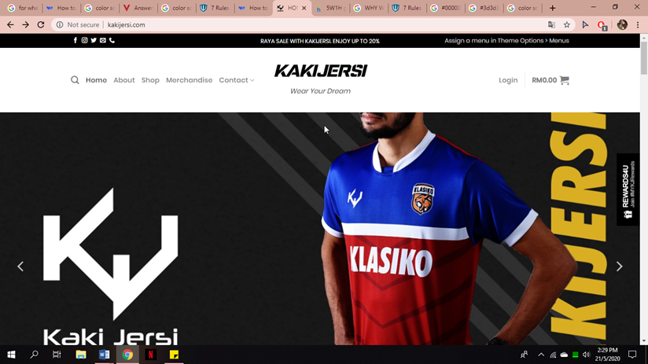

Slide 14
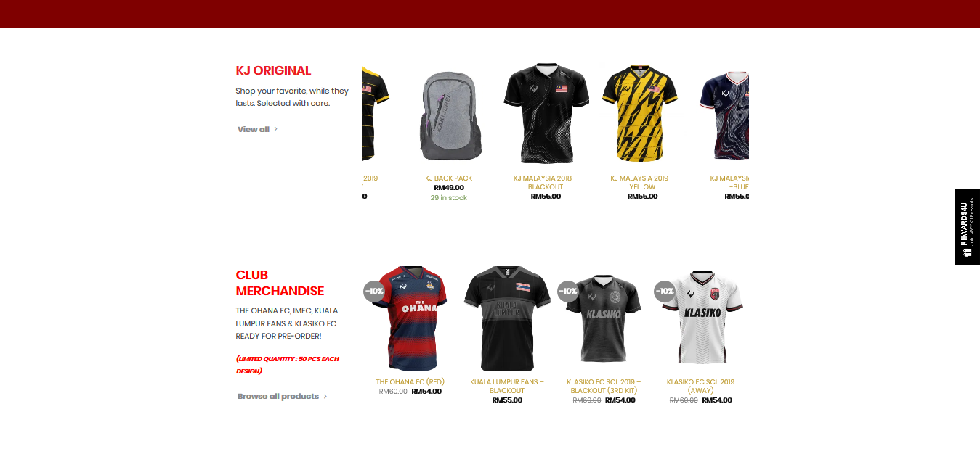

Slide 15
WHO
Most tend to have a distinct color scheme associated with their brand identity.
Kaki Jersi used plain background color to keeps their visitors' focus on their content and products.
WHY
For websites that have a lot of content, especially a lot of words and picture of products
It is best to choose a white background for a clean and easy-to-read look.
WHAT
The used of red color is to highlight or to draw attention on important information in a text.
To make visitors focus on Kaki Jersi product and content.

Slide 16
WHEN
The color scheme that they used are suitable for their target customers
WHERE
These websites used white (#FFFFFF) on their background
Black (#000000) on header and footer.
Red (#ff0000) is to highlight or to draw attention to important information in website.
HOW
For kakijersi.com, when people see the red color, it will triggers emotional responses like excitement.

Slide 17
5. NAVIGATION OF THE WEBSITE

Slide 18
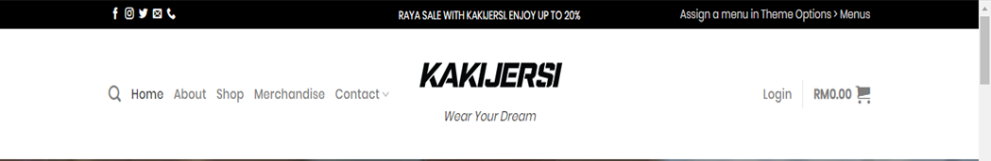
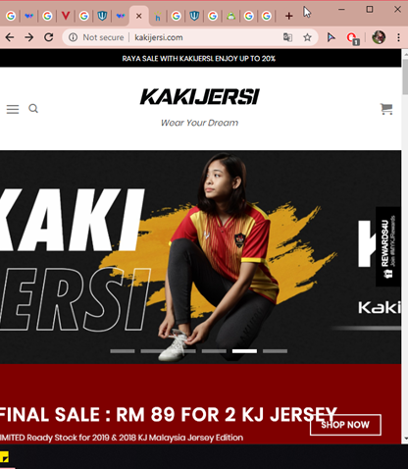
WHAT
Responsive navigation bar.
The hamburger menu.

Slide 19
WHO
For their customer to navigate with ease and have a great experience when browsing the website
WHY
Navigation bar is the most important one, in fact it is the first section that the user sees. When they enter a website and it links to the other main parts in the website.
Kaki Jersi’s websites uses hamburger menu to hide the navigation menu especially when customer browse their website using mobile devices.

Slide 20
WHERE
The navigation bar very accessible and it will make it easier for user to choose where they want to be in this website.
Through our finding with this website, Kaki Jersi website has 5 section which is “Home”, “About”, “Shop”,” Merchandise” and “Contact”
HOW
A website navigation bar is most commonly displayed as horizontal list of links at the top of each page.

Slide 21
6. CONTENT OF THE WEBSITE

Slide 22
WHO
Customer and clients.
Individual or companies.
WHAT
Hari Raya Surprise sale.
Home.
About.
Shop.
Merchandise.
Contact.
WHEN
Customers and clients can access whenever the want to do so.

Slide 23
WHY
Advertising.
Informing and engaging target audience.
Attract customers.
WHERE
Search engine at the top of the sites.
HOW
They are working to build confidence by helping consumers to know their business, the first stage in building long-term customer relations.

